Slide 1

Forecasting Bitcoin Prices with Auto-SARIMA Model: A Time Series Analysis

Slide 2
Agenda
1
2
3
4
5
Abstract
Introduction
Proposed Work
Results
Conclusion

Slide 3

Abstract
A digital form of currency known as a cryptocurrency stores all transactions in sets of records known as blocks. Even if there are other virtual currencies, like Cardano, Polygon, Luna, and Ethereum, our study will concentrate on Bitcoin.
Time series analysis, machine learning, sentiment analysis, and network analysis are just a few of the several methods that are currently being utilised to anticipate the price of bitcoin. Forecasts regarding the price of bitcoin are always being updated and improved by academics. This study investigates how the Auto-Sarima model may be used to forecast Bitcoin values. The Auto-Sarima model is an advanced mathematical model that produces precise forecasts by accounting for several variables, such as past pricing data and outside variables.

Slide 4
Introduction
A type of digital or virtual money known as cryptocurrency uses codebreaking methods to safeguard its transactions and runs without the aid of a central bank. It lacks a physical form and is not governed by any government or financial organisation, unlike conventional cash. Each with its own unique features and purposes. Cryptocurrencies are often used as an exchangeable currency or investment asset.

Slide 5
Proposed Work
Sample data preparation​
Normalization
Auto-Sarima method​
This technique scales the values of a feature to a range between 0 and 1. It ranks among the majorly well-liked and powerful techniques for scaling the dataset. The minimum value is given zero and maximum value 1.
Auto SARIMA automates the process of selecting the best SARIMA model for a given time series dataset. It accomplishes this by employing an algorithm that examines a variety of potential SARIMA models.
1)Collecting Data
2) Discover Data
3) Cleanse and Verify Data ​4) Transform Data
5)Saving the data

Slide 6
Proposed work
.
LGBM
A gradient boosting system called Light GBM (LGBM) employs a tree-based learning mechanism. It is among the utmost popular predictive analysis algorithm for tabular data since it is made to be effective, scalable.
.
Auto-Sarima
The algorithm first determines the order of differencing needed to make the time series stationary. If the data is not stationary, the algorithm applies differencing to the time series until it becomes stationary.
.
.
Ensemble model
Ensemble modelling is the process of creating multiple diverse models that can forecast any result utilizing range of modelling techniques or training sets of data.
Default Forecaster
The Default Forecaster Model is a straightforward forecasting model that extrapolates future values from the most recent observation.

Slide 7
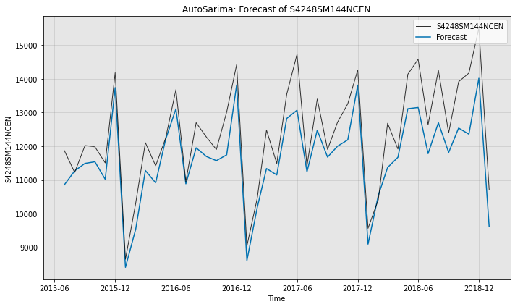
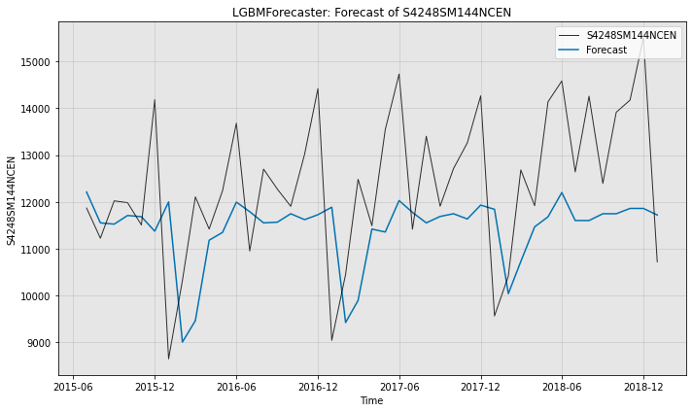
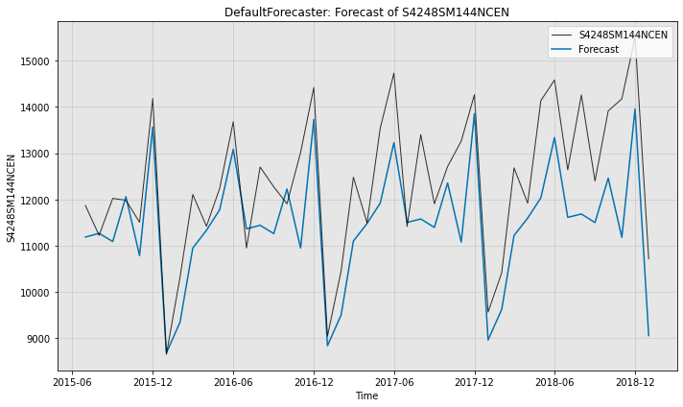
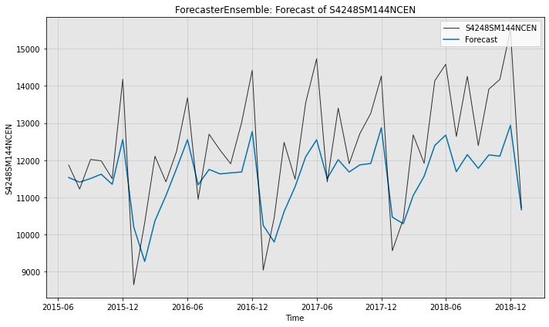
Comparision

Slide 8
Results
The accuracy is given by formula:
Accuracy = (number of correct predictions) / (total number of predictions).
We compare the number of correct predictions with total number of predictions. The main focus of this part is that we concentrate on increasing the number of correct predictions by choosing the appropriate model. In figure we see that accuracy scores of Auto Sarima are much higher than other models indicating that it can predict the results better than other models. Auto Sarima is preferred for forecasting because of its higher accuracy.

Slide 9
INFERENCE
“
The use of AutoSarima has helped us to get a good understanding of prediction models. Compared to manual model selection, Auto SARIMA has a number of benefits. First off, it can help you save a ton of time and work when choosing a model. It can take a lot of effort and extensive time series modelling knowledge to manually search through a variety of potential SARIMA models
“
Second, Auto SARIMA can assist in confirming that the model chosen is suitable for the time series data. Manually choosing a model can result in the data being overfitted or underfitted, which will have a negative impact on the accuracy of future predictions. Auto SARIMA uses a chosen criterion to evaluate the goodness of fit of each model and penalize for model complexity, helping to avoid overfitting

Slide 10
References
[1] Shin, M.; Mohaisen, D.; Kim, J. Bitcoin price forecasting via ensemble-based LSTM deep learning networks. In Proceedings of the 2021 International Conference on Information Networking (ICOIN), Jeju Island, Korea, 13–16 January 2021; Volume 1, pp. 603–608.
[2] Jagannath, N.; Barbulescu, T.; Sallam, K.M.; Elgendi, I. A Self-Adaptive Deep Learning-Based Algorithm for Predictive Analysis of Bitcoin Price. IEEE Access 2021, 9, 34054–34066.
[3] Guo, H.Z.; Zhang, D.; Liu, S.Y.; Wang, L. Bitcoin price forecasting: A perspective of underlying blockchain transactions. Decis. Support Syst. 2021, 151, 113650.
[4] Dhanya, N. M. "An Empirical Evaluation of Bitcoin Price Prediction Using Time Series Analysis and Roll Over." In Inventive Communication and Computational Technologies, pp. 327-339. Springer, Singapore, 2021.
[5] Ibrahim, A.; Kashef, R.; Li, M.; Valencia, E.; Huang, E. Bitcoin network mechanics: Forecasting the btc closing price using vector auto-regression models based on endogenous and exogenous feature variables. J. Risk Financ. Manag. 2020, 13, 189.
[6] Livieris, I.E., Pintelas, E., Pintelas, P.: A CNN-LSTM model for gold price time series forecasting. Neural Comput. Appl. (2020).
[7] Paresh Kumar N, Narayan S, Rahman RE, Setiawan I (2019) Bitcoin price growth and Indonesia’s monetary system. Emerg Mark Rev 38:364–376.
[8] Shintate, T.; Pichl, L. Trend Prediction Classification for High Frequency Bitcoin Time Series with Deep Learning. J. Risk Financ. Manag. 2019, 12, 17.

Slide 11
Conclusion
The research paper on Bitcoin price prediction has explored various machine learning algorithms and their effectiveness in forecasting Bitcoin prices. As a result, the prescribed algorithm is predicting the bitcoin price much more precisely than other prediction models. Auto Sarima is a better model for predicting bitcoin and other crypto currency prices. This helps traders to get a better insight of what is happening in the market and what will happen in the future.

Slide 12

Thank you

